Slide 1

Accelerating
Electric Mobility
in India
Amit Bhatt
Director, Integrated Transport
WRI India
amit.bhatt@wri.org

Slide 2
Improved air quality in Indian cities
Out of the 15 most polluted cities of the world are in India
14
Of NOx emissions in Delhi were due to vehicles in 2016
36%
Of PM2.5 emissions in Delhi were due to vehicles in 2016
25%
The Economist, 2018

Slide 3
Potential gains from EV
Social, Environmental and Economic
Increases Plant Load Factor
Promotes renewables
Enhances energy security
Technological leadership
Better air quality
GHG mitigation
Improving public health in cities
Towards a greener India
Through EV batteries
Reduces imported fuel use in transport sector
Increases efficiency of power plants
Position India as a leader in auto-tech
Notes:
Improved air quality
Reduced dependence on imported fuel
Reduced emission of Greenhouse Gases
Increased share of renewables with battery storage systems
Contributes to improved Plant Load Factor (PLF)
Be a leader in a rapidly growing global market

Slide 4
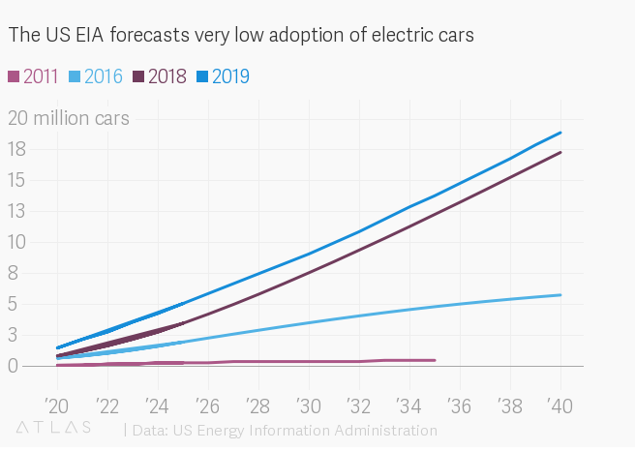
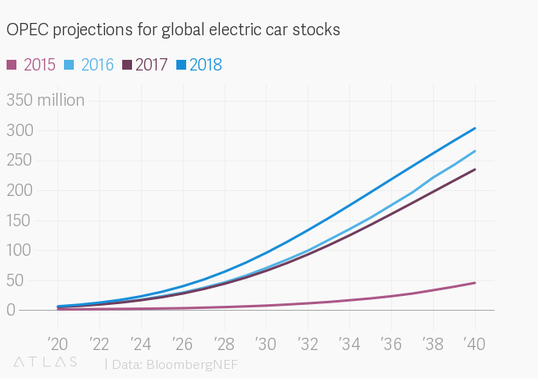
Growth in Electric Vehicle Growth Projections
Source: IEA 2018

Slide 5
Composition of the vehicle fleet
98% of the vehicles:
  small and affordable vehicles (two-wheelers and economy cars)
  public transport
  goods vehicles (three-wheelers, small goods vehicles, buses and trucks)
Only 2% of the vehicles are high end cars, unlike in developed countries
SIAM 2017, Jhunjhunwala and Kaur 2018
Notes:
Do not understand the bar-chart. Is it fro passenger vehicles alone?
Re-arrange the charts

Slide 6
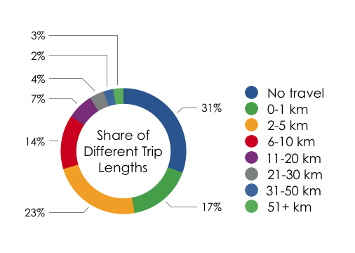
Trip lengths
High urban densities. India lives and moves differently.
An average vehicle would travel much less in India as compared to the developed world
71%
Of the trips are of less than 5 km
16%
Of the trips are of length greater than 10 km
Census 2011

Slide 7
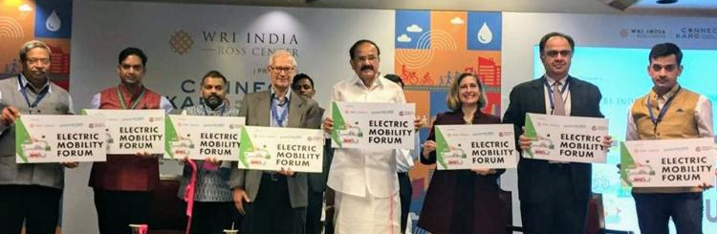
Electric Mobility forum
Convening
Mentoring
Scaling

Slide 8
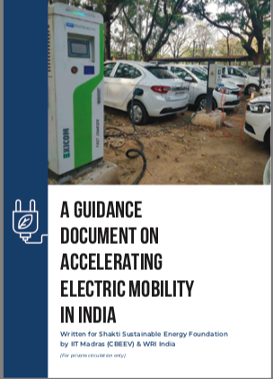



Center for Battery Engineering EVs (CBEEV),
IIT Madras

Slide 9
Pillars of an electric mobility ecosystem
ELECTRIC VEHICLE
All-electric, plug-in hybrid, hybrid
RE-ENERGISING SYSTEMS
Charging and swapping infrastructure
BATTERIES
Lithium Ion batteries – NMC, LTO, LFP
Battery Management System
OTHER FACTORS
Manufacturing capacity, research and development, power grid

Slide 10
Thank You

